Slide 1
Asymmetric Privacy-Preserving Multi-Keyword Fuzzy Search over Encrypted Cloud Data using Multi-Probe LSH
Shubh Khandelwal
CS22B1090
Dr. Sanjeet Kumar Nayak
Dept. of CSE, IIITDM Kancheepuram

Slide 2
Table of Contents
Introduction
Problem Definition
Literature Survey
Contribution
Progress/ Work done
Results/ Analysis
Prototype/ Products
Conclusion
Future Work

Slide 3

Introduction
Cloud computing requires keyword search over encrypted data
Traditional encryption makes data retrieval entirely unfeasible
Existing symmetric schemes have key management bottlenecks
Asymmetric cryptography provides flexible, multi-user access control

Slide 4
Problem Definition
Standard LSH introduces a trade-off between false positives and false negatives.
Symmetric schemes prevent granular, user-specific search permissions.
Multi-user environments make symmetric key distribution highly impractical.
Standard LSH algorithms inherently produce high false negative rates.

Slide 5
Literature Survey
Feature | Wang et al. (2014) | Cheng et al. (2022) | Cheng et al. (2025) | Your Scheme
Encryption Type | Symmetric | Symmetric (SSE) | Asymmetric (Public Key) | Asymmetric (PEKS)
Core Method | LSH + Bloom Filter | LSH + Index Tree | Similarity Vector (Dice) | Multi-Probe LSH + PEKS
Fuzzy Logic | Euclidean Similarity | Edit Distance / Jaccard | Dice Similarity | Euclidean / Cosine (LSH)
Search Type | Multi-keyword Ranked | Verifiable Multi-keyword | Similarity Test (Equality+) | Multi-keyword Fuzzy
Key Innovation | First multi-keyword fuzzy search. | Adaptive security & result verification. | Light-weight similarity test for medical data. | Reduced LSH storage & Asymmetric access.

Slide 6
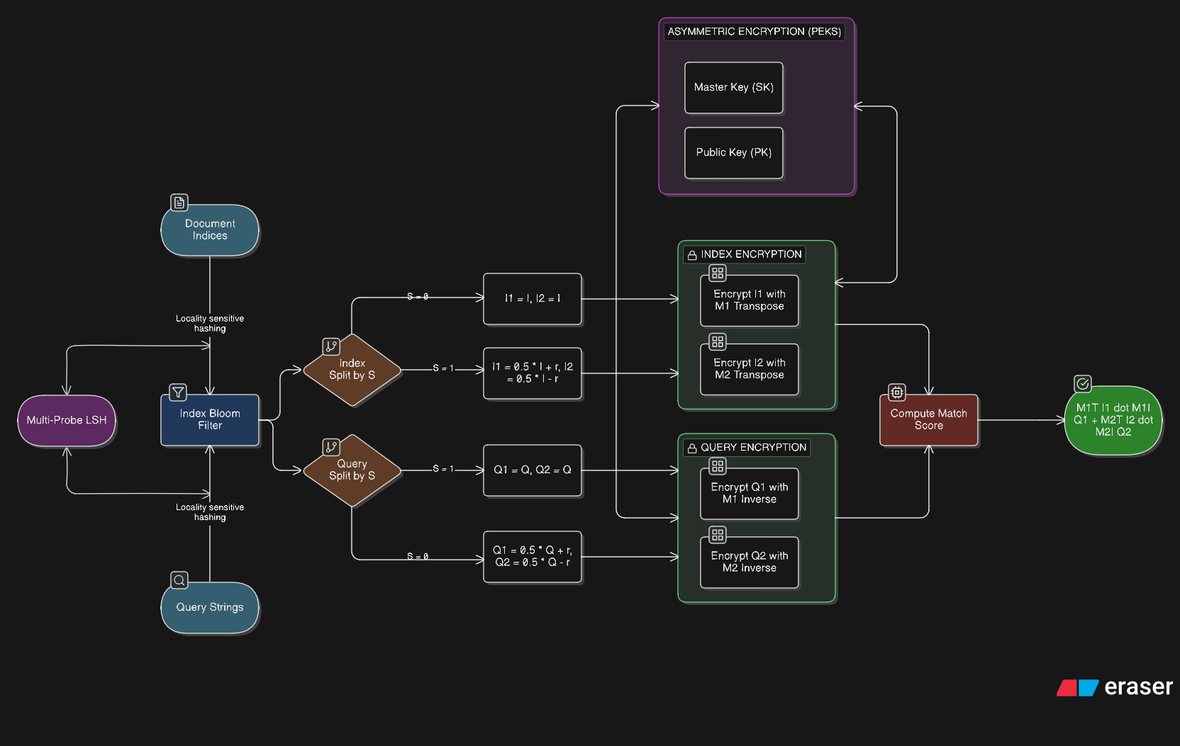
System Architecture

Slide 7
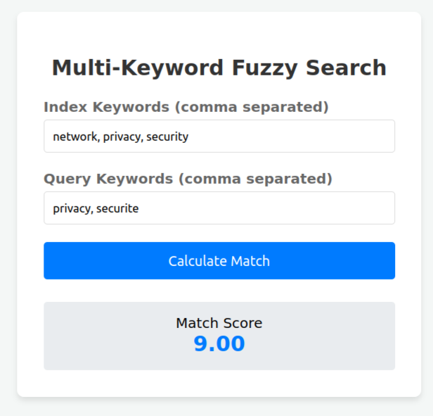
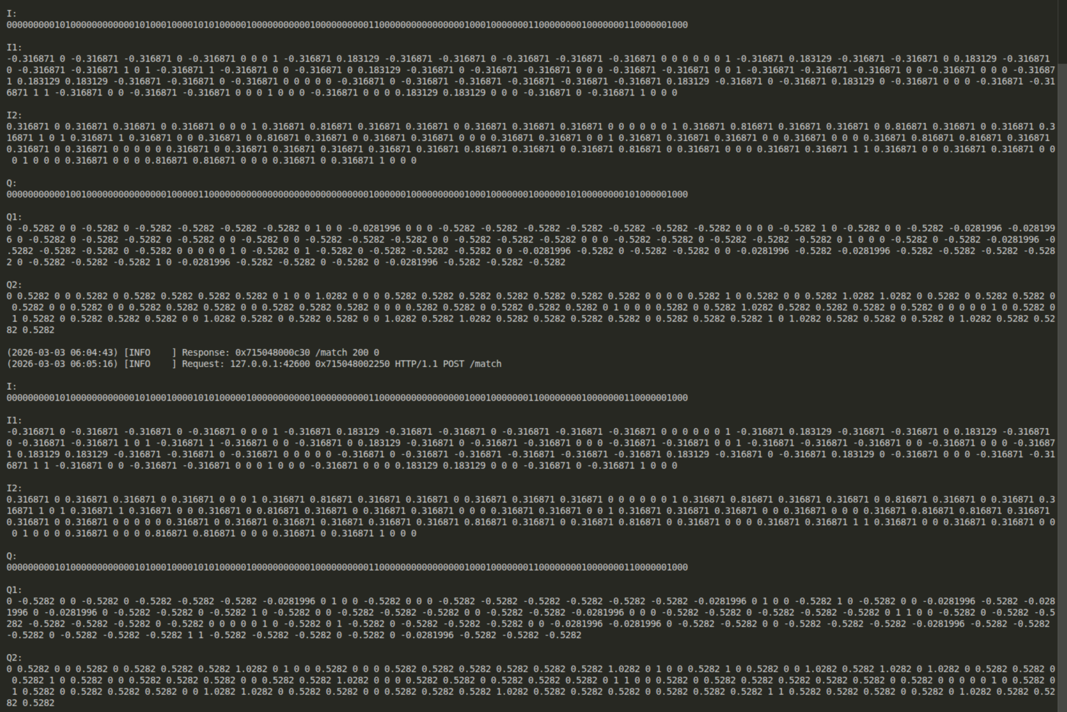
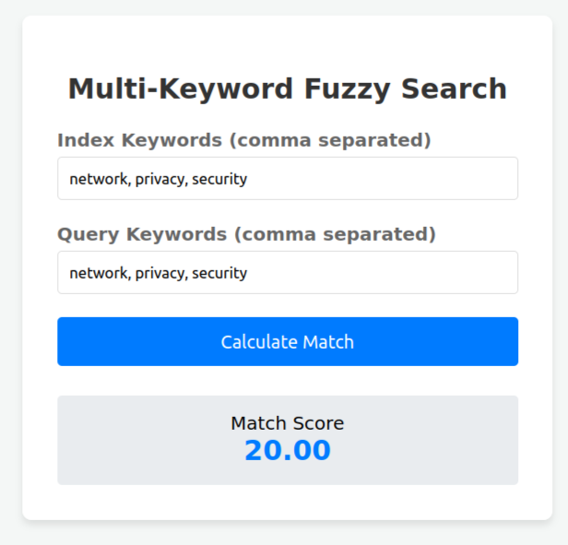
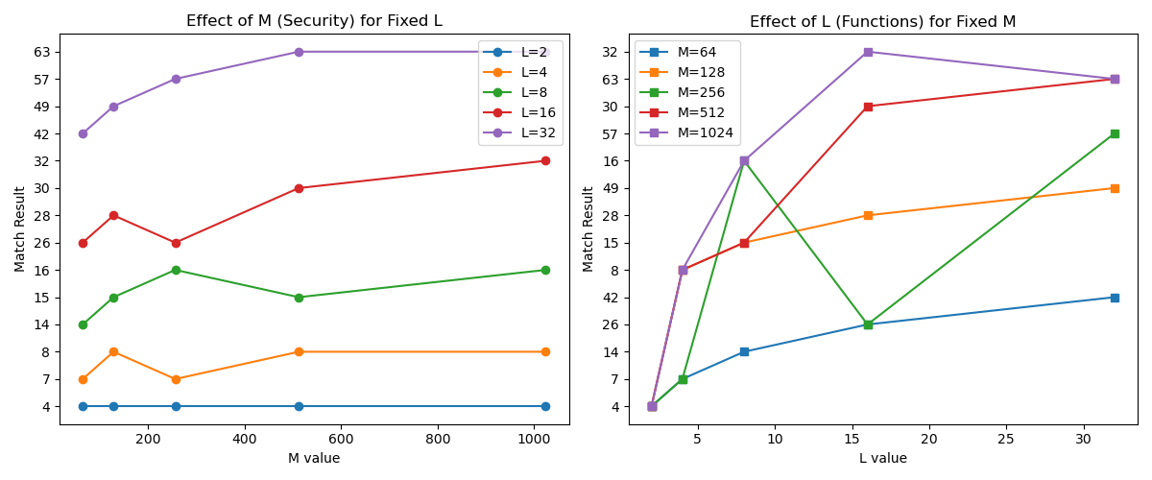
Analysis/ Results

Slide 8
Contributions/ Work Done
Symmetric search over encrypted data using LSH
Randomly generated invertible matrices for data encryption
Testing the scheme for 32, 128, 256, 1000, 2000, 8000 bloom filter sizes
Analyzing difference between dissimilar words using variable box width
Decreasing real-time space used using bitset and active indexing

Slide 9
Conclusion
Multiple issues with false negatives; “apple” and “netword” giving similar match scores with not much difference on small bloom filter size
Large bloom filter sizes not able to provide “fuzziness” to the search
Not suitable for multi-user environments; need differentiation for different types of users

Slide 10
Future Work
Implement multi-probe LSH for the scheme to bring similar queries closer even closer while increasing distance between dissimilar queries
Implement Public Key Encryption with Keyword Search on the scheme to allow multiple users to access while providing another layer of security from the server and making the server virtually blind
Implement a verification system to evaluate the match score with respect to the similarity between the searches

Slide 11
References
Cheng, X., Guo, R., Chen, Z., Chen, J., Cao, Z., Wang, L., Dong, X., Li, W., Susilo, W., Xia, C., Wang, T., Zhao, Z., Zeng, S., Cheng, S., & Hao, F. (2025). PKEST: Public-Key Encryption With Similarity Test for Medical Consortia Cloud Computing. IEEE Transactions on Cloud Computing, 13(2), 680–693.
Cheng, X., Guo, R., Chen, Z., Cao, Z., Dong, X., & Susilo, W. (2022). Verifiable Fuzzy Multi-Keyword Search Over Encrypted Data With Adaptive Security. IEEE Transactions on Cloud Computing, 10(4), 2686–2699.
B. Wang, S. Yu, W. Lou, and Y. T. Hou, “Privacy-preserving multi-keyword fuzzy search over encrypted data in the cloud,” in IEEE INFOCOM 2014-IEEE Conference on Computer Communications. IEEE, 2014, pp. 2112–2120.

Slide 12
Thank You Any Questions?

